Slide 1
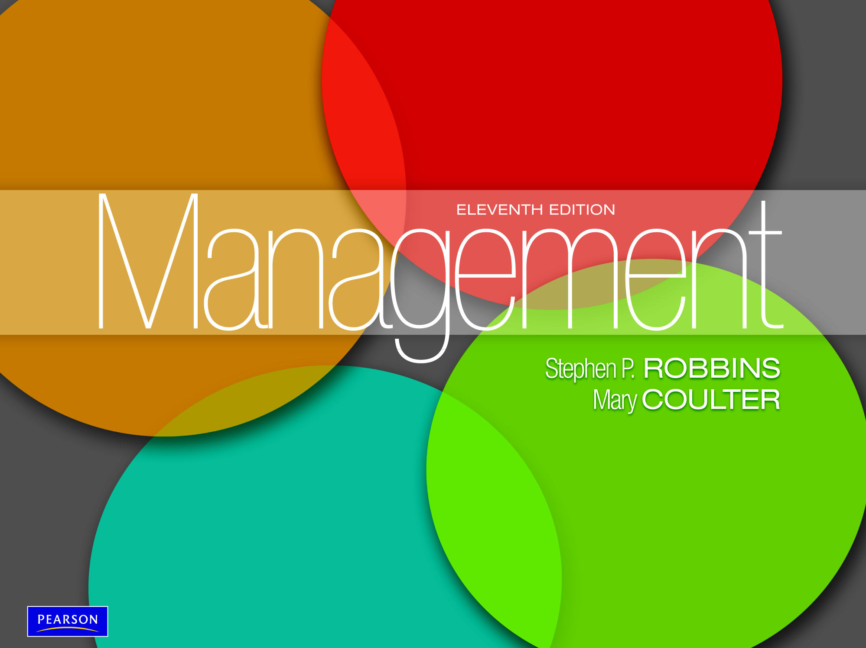
Human Resource Management
Chapter 12

Slide 2
L E A R N I N G O U T L I N E Follow this Learning Outline as you read and study this chapter.
Why Human Resources Is Important: The HRM Process
Explain how an organization’s human resources can be a significant source of competitive advantage.
List eight activities necessary for staffing the organization and sustaining high employee performance.
Discuss the environmental factors that most directly affect the HRM process.

Slide 3
L E A R N I N G O U T L I N E (cont’d) Follow this Learning Outline as you read and study this chapter.
Human Resource Planning; Recruitment/ Decruitment; Selection; Orientation; Training
Contrast job analysis, job description, and job specification.
Discuss the major sources of potential job candidates.
Describe the different selection devices and which work best for different jobs.
Tell what a realistic job preview is and why it’s important.
Explain why orientation is so important.
Describe the different types of training and how that training can be provided.

Slide 4
L E A R N I N G O U T L I N E (cont’d) Follow this Learning Outline as you read and study this chapter.
Employee Performance Management; Compensation/Benefits; Career Development
Describe the different performance appraisal methods.
Discuss the factors that influence employee compensation and benefits.
Describe skill-based and variable pay systems.
Describe career development for today’s employees.
Current Issues in Human Resource Management
Explain how managers can manage downsizing.
Discuss how managers can manage workforce diversity.

Slide 5
L E A R N I N G O U T L I N E (cont’d) Follow this Learning Outline as you read and study this chapter.
Current Issues in Human Resource Management (cont’d)
Explain what sexual harassment is and what managers need to know about it.
Describe how organizations are dealing with work-life balances.

Slide 6
The Importance of Human Resource Management (HRM)
As a necessary part of the organizing function of management
Selecting, training, and evaluating the work force
As an important strategic tool
HRM helps establish an organization’s sustainable competitive advantage.
Adds value to the firm
High performance work practices lead to both high individual and high organizational performance.

Slide 7
Exhibit 12–1 Examples of High-Performance Work Practices
Self-managed teams
Decentralized decision making
Training programs to develop knowledge, skills, and abilities
Flexible job assignments
Open communication
Performance-based compensation
Staffing based on person–job and person–organization fit

Slide 8
The HRM Process
Functions of the HRM Process
Ensuring that competent employees are identified and selected.
Providing employees with up-to-date knowledge and skills to do their jobs.
Ensuring that the organization retains competent and high-performing employees who are capable of high performance.

Slide 9
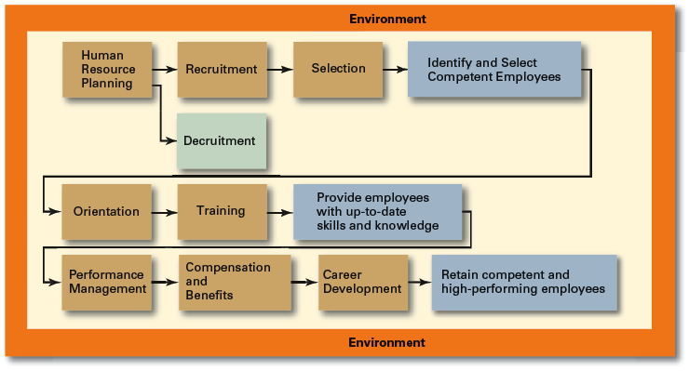
Exhibit 12–2 Human Resource Management Process

Slide 10
Environmental Factors Affecting HRM
Employee Labor Unions
Organizations that represent workers and seek to protect their interests through collective bargaining.
Collective bargaining agreement
A contractual agreement between a firm and a union elected to represent a bargaining unit of employees of the firm in bargaining for wage, hours, and working conditions.
Governmental Laws and Regulations
Limit managerial discretion in hiring, promoting, and discharging employees.
Affirmative Action: the requirement that organizations take proactive steps to ensure the full participation of protected groups in its workforce.

Slide 11
Exhibit 12–3 Major U.S. Federal Laws and Regulations Related to HRM
1963 Equal Pay Act
1964 Civil Rights Act, Title VII (amended in 1972)
1967 Age Discrimination in Employment Act
1973 Vocational Rehabilitation Act
1974 Privacy Act
1978 Mandatory Retirement Act
1986 Immigration Reform and Control Act
1988 Worker Adjustment and Retraining Notification Act
1990 Americans with Disabilities Act
1991 Civil Rights Act of 1991
1993 Family and Medical Leave Act of 1993
1996 Health Insurance Portability and Accountability Act of 1996
2003 Fair and Accurate Credit Transactions Act
2004 FairPay Overtime Initiative

Slide 12
Managing Human Resources
Human Resource (HR) Planning
The process by which managers ensure that they have the right number and kinds of people in the right places, and at the right times, who are capable of effectively and efficiently performing their tasks.
Helps avoid sudden talent shortages and surpluses.
Steps in HR planning:
Assessing current human resources
Assessing future needs for human resources
Developing a program to meet those future needs

Slide 13
Current Assessment
Human Resource Inventory
A review of the current make-up of the organization’s current resource status
Job Analysis
An assessment that defines a job and the behaviors necessary to perform the job
Knowledge, skills, and abilities (KSAs)
Requires conducting interviews, engaging in direct observation, and collecting the self-reports of employees and their managers.

Slide 14
Current Assessment (cont’d)
Job Description
A written statement of what the job holder does, how it is done, and why it is done.
Job Specification
A written statement of the minimum qualifications that a person must possess to perform a given job successfully.

Slide 15
Meeting Future Human Resource Needs
Supply of Employees
Demand for Employees
Factors Affecting Staffing
Strategic Goals
Forecast demand for products and services
Availability of knowledge, skills, and abilities

Slide 16
Recruitment and Decruitment
Recruitment
The process of locating, identifying, and attracting capable applicants to an organization
Decruitment
The process of reducing a surplus of employees in the workforce of an organization
E-recruiting
Recruitment of employees through the Internet
Organizational web sites
Online recruiters

Slide 17
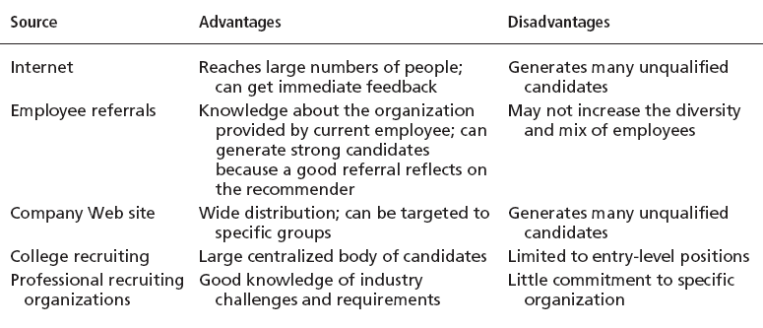
Exhibit 12–4 Major Sources of Potential Job Candidates

Slide 18
Selection
Selection Process
The process of screening job applicants to ensure that the most appropriate candidates are hired.
What is Selection?
An exercise in predicting which applicants, if hired, will be (or will not be) successful in performing well on the criteria the organization uses to evaluate performance.
Selection errors:
Reject errors for potentially successful applicants
Accept errors for ultimately poor performers

Slide 19
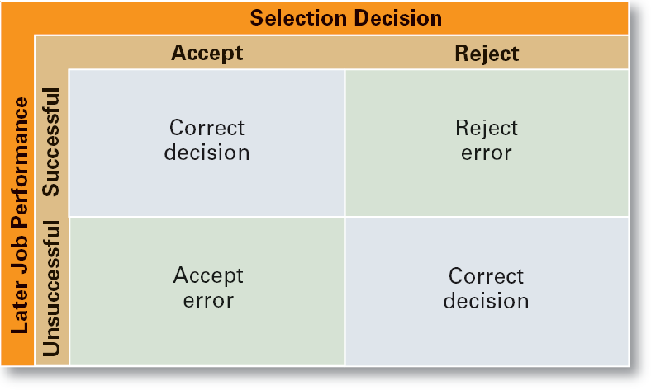
Exhibit 12–6 Selection Decision Outcomes

Slide 20
Validity and Reliability
Validity (of Prediction)
A proven relationship between the selection device used and some relevant criterion for successful performance in an organization.
High tests scores equate to high job performance; low scores to poor performance.
Reliability (of Prediction)
The degree of consistency with which a selection device measures the same thing.
Individual test scores obtained with a selection device are consistent over multiple testing instances.

Slide 21
Exhibit 12–7 Selection Devices
Application Forms
Written Tests
Performance Simulations
Interviews
Background Investigations
Physical examinations

Slide 22
Written Tests
Types of Tests
Intelligence: how smart are you?
Aptitude: can you learn to do it?
Attitude: how do you feel about it?
Ability: can you do it now?
Interest: do you want to do it?
Legal Challenges to Tests
Lack of job-relatedness of test items or interview questions to job requirements
Discrimination in equal employment opportunity against members of protected classes

Slide 23
Performance Simulation Tests
Testing an applicant’s ability to perform actual job behaviors, use required skills, and demonstrate specific knowledge of the job.
Work sampling
Requiring applicants to actually perform a task or set of tasks that are central to successful job performance.
Assessment centers
Dedicated facilities in which job candidates undergo a series of performance simulation tests to evaluate their managerial potential.

Slide 24
Other Selection Approaches
Interviews
Although used almost universally, managers need to approach interviews carefully.
Background Investigations
Verification of application data
Reference checks:
Lack validity because self-selection of references ensures only positive outcomes.
Physical Examinations
Useful for physical requirements and for insurance purposes related to pre-existing conditions.

Slide 25
Exhibit 12–8 Suggestions for Interviewing
Structure a fixed set of questions for all applicants.
Have detailed information about the job for which applicants are interviewing.
Minimize any prior knowledge of applicants’ background, experience, interests, test scores, or other characteristics.
Ask behavioral questions that require applicants to give detailed accounts of actual job behaviors.
Use a standardized evaluation form.
Take notes during the interview.
Avoid short interviews that encourage premature decision making.

Slide 26
Exhibit 12–9 Examples of “Can’t Ask and Can Ask” Interview Questions for Managers*
Can’t Ask
What’s your birth date? or How old are you?
What’s your marital status? or Do you plan to have a family?
What’s your native language?
Have you ever been arrested?
Can Ask
Are you over 18?
Would you relocate?
Are you authorized to work in the United States?
Have you ever been convicted of [fill in the blank]?—The crime must be reasonably related to the performance of the job.
* Note: Managers should be aware that there are numerous other “can and can’t ask” questions. Be sure to always check with your HR department for specific guidance.

Slide 27
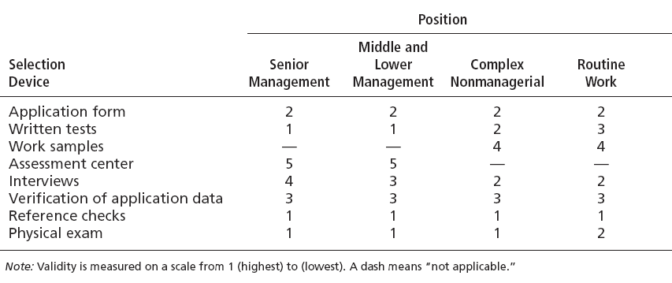
Exhibit 12–10 Quality of Selection Devices as Predictors

Slide 28
Other Selection Approaches (cont’d)
Realistic Job Preview (RJP)
The process of relating to an applicant both the positive and the negative aspects of the job.
Encourages mismatched applicants to withdraw.
Aligns successful applicants’ expectations with actual job conditions; reducing turnover.

Slide 29
Orientation
Transitioning a new employee into the organization.
Work-unit orientation
Familiarizes new employee with work-unit goals
Clarifies how his or her job contributes to unit goals
Introduces he or she to his or her coworkers
Organization orientation
Informs new employee about the organization’s objectives, history, philosophy, procedures, and rules.
Includes a tour of the entire facility

Slide 30
Exhibit 12–11 Types of Training
Type | Includes
General | Communication skills, computer systems application and programming, customer service, executive development, management skills and development, personal growth, sales, supervisory skills, and technological skills and knowledge
Specific | Basic life/work skills, creativity, customer education, diversity/cultural awareness, remedial writing, managing change, leadership, product knowledge, public speaking/presentation skills, safety, ethics, sexual harassment, team building, wellness, and others

Slide 31
Exhibit 12–12 Employee Training Methods
Traditional Training Methods
On-the-job
Job rotation
Mentoring and coaching
Experiential exercises
Workbooks/manuals
Classroom lectures
Technology-Based Training Methods
CD-ROM/DVD/videotapes/ audiotapes
Videoconferencing/ teleconferencing/ satellite TV
E-learning

Slide 32
Employee Performance Management
Performance Management System
A process of establishing performance standards and appraising employee performance in order to arrive at objective HR decisions and to provide documentation in support of those decisions.

Slide 33
Exhibit 12–13 Advantages and Disadvantages of Performance Appraisal Methods
Method | Advantage | Disadvantage
Written essays | Simple to use | More a measure of evaluator’s writing ability than of employee’s actual performance
Critical incidents | Rich examples; behaviorally based | Time-consuming; lack quantification
Graphic rating scales | Provide quantitative data; less time-consuming than others | Do not provide depth of job behavior assessed
BARS | Focus on specific and measurable job behaviors | Time-consuming; difficult to develop
Multiperson comparisons | Compares employees with one another | Unwieldy with large number of employees; legal concerns
MBO | Focuses on end goals; results oriented | Time-consuming
360-degree appraisals | Thorough | Time-consuming

Slide 34
Compensation and Benefits
Benefits of a Fair, Effective, and Appropriate Compensation System
Helps attract and retain high-performance employees
Impacts on the strategic performance of the firm
Types of Compensation
Base wage or salary
Wage and salary add-ons
Incentive payments
Skill-based pay
Variable pay

Slide 35
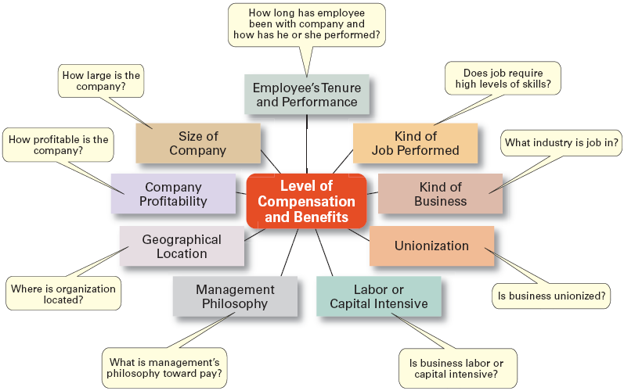
Exhibit 12–14 Factors That Influence Compensation and Benefits
Sources: Based on R.I. Henderson, Compensation Management, 6th ed. (Upper Saddle River, NJ: Prentice Hall, 1994), pp. 3–24; and A. Murray, “Mom, Apple Pie, and Small Business,” Wall Street Journal, August 15, 1994, p. A1

Slide 36
Career Development
Career Defined
The sequence of positions held by a person during his or her lifetime.
The Way It Was
Career Development
Provided for information, assessment, and training
Helped attract and retain highly talented people
Now
Individuals—not the organization—are responsible for designing, guiding, and developing their own careers.
Boundaryless Career
A career in which individuals, not organizations, define career progression and organizational loyalty

Slide 37
Exhibit 12–15 What College Graduates Want From Jobs
Top Factors for U.S. Students
Work–life balance
Annual base salary
Job stability and security
Recognition for a job done well
Increasingly challenging tasks
Rotational programs
Top Factors for U.K. Students
International career opportunities
Flexible working hours
Variety of assignments
Paid overtime

Slide 38
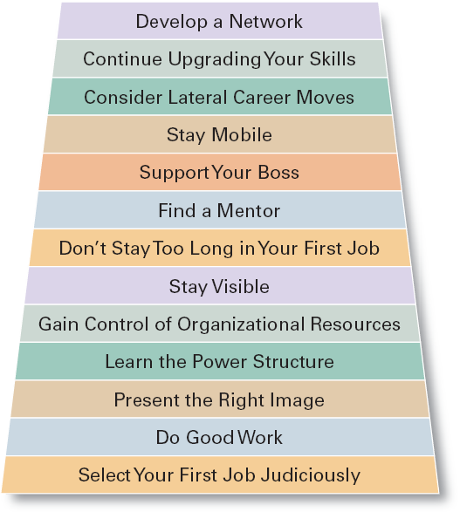
Exhibit 12–16 Some Suggestions for a Successful Management Career

Slide 39
Current Issues in HRM
Managing Downsizing
The planned elimination of jobs in an organization
Provide open and honest communication.
Provide assistance to employees being downsized.
Reassure and counseling to surviving employees.
Managing Work Force Diversity
Widen the recruitment net for diversity
Ensure selection without discrimination
Provide orientation and training that is effective

Slide 40
Current Issues in HRM (cont’d)
Sexual Harassment
An unwanted activity of a sexual nature that affects an individual’s employment.
Unwanted sexual advances, requests for sexual favors, and other verbal or physical conduct of a sexual nature when submission or rejection of this conduct explicitly or implicitly affects an individual’s employment.
An offensive or hostile environment
An environment in which a person is affected by elements of a sexual nature.
Workplace Romances
Potential liability for harassment

Slide 41
Current Issues in HRM (cont’d)
Work-Life Balance
Employees have personal lives that they don’t leave behind when they come to work.
Organizations have become more attuned to their employees by offering family-friendly benefits:
On-site child care
Summer day camps
Flextime
Job sharing
Leave for personal matters
Flexible job hours

Slide 42
Current Issues in HRM (cont’d)
Controlling HR Costs
Employee health-care
Encouraging healthy lifestyles
Financial incentives
Wellness programs
Charging employees with poor health habits more for benefits
Employee pension plans
Reducing pension benefits
No longer providing pension plans

Slide 43
Terms to Know
high-performance work practices
human resource management process
labor union
affirmative action
human resource planning
job analysis
job description
job specification
recruitment
decruitment
selection
validity
reliability
work sampling
assessment centers
realistic job preview (RJP)
orientation
performance management system
written essay
critical incidents
graphic rating scales

Slide 44
Terms to Know (cont’d)
behaviorally anchored rating scales (BARS)
multiperson comparisons
360 degree feedback
skill-based pay
variable pay
career
downsizing
sexual harassment
family-friendly benefits

